Slide 1

Career Shift to Data: Unveiling Job Satisfaction, Salary, and Industry Trends
- Mayur Dusane
- Mayur Dusane

Slide 2
Executive Summary
The Power BI data analyst project focused on analyzing a dataset containing various factors related to individuals' current roles, career transitions, salaries, job satisfaction, and demographics.
Through Power BI's interactive dashboards, this data analyst project provided a comprehensive view of the dataset, enabling stakeholders to gain insights into job titles, salaries, job satisfaction, career transitions, and demographics within the industry.
The project's findings can be used to inform strategic decision-making, identify areas for improvement, and tailor recruitment and retention strategies to attract and retain top talent.

Slide 3
Problem Statement
To analyze the job satisfaction and career trends in the field of data analysis. We aim to gain insights into factors that contribute to job satisfaction among data professionals and understand the challenges they face in the industry. By analyzing survey data that includes information such as job titles, salaries, work-life balance, coworker relationships, and career progression, we will create interactive dashboards to visualize and explore these aspects. The goal is to provide valuable insights for both data professionals and employers to improve job satisfaction and address career-related challenges in the industry.

Slide 4
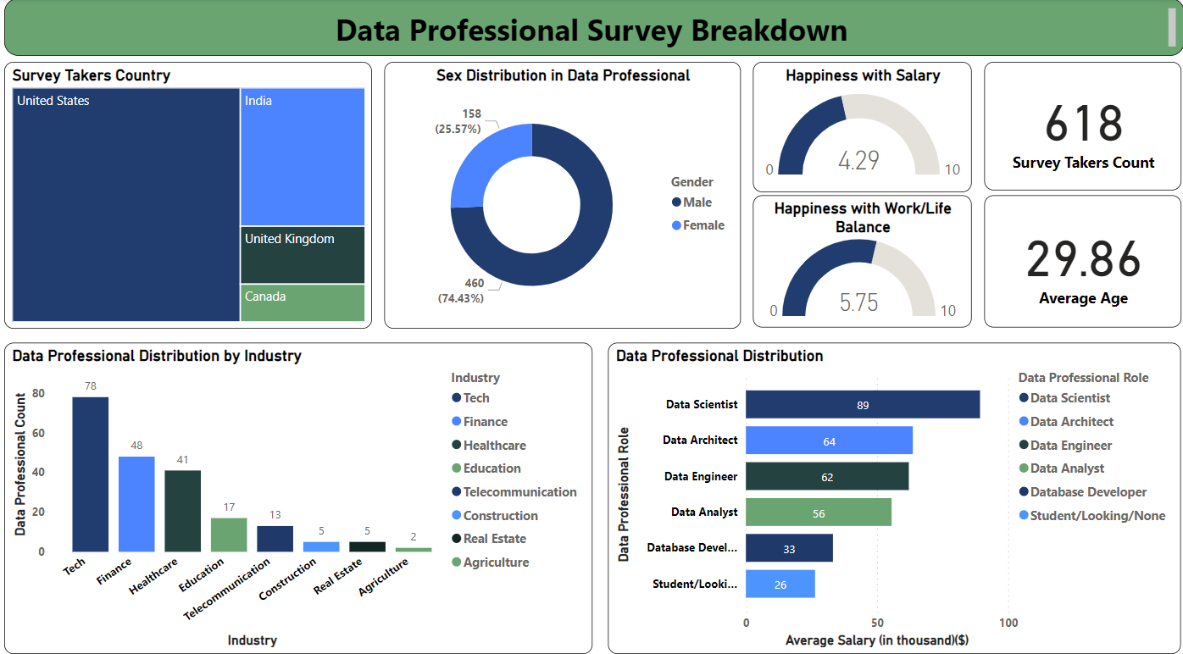
Dashboard

Slide 5
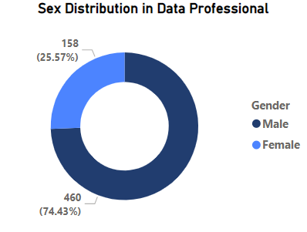
Data Professional Distribution by Gender
Male data professional count is higher that female data professional count.
Total count of data professional is 618.

Slide 6
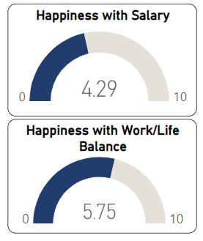
Job Satisfaction
The relatively low ratings for both salary and work-life balance highlight the importance of considering employee well-being in the workplace.
Employers should focus on providing competitive compensation packages while also fostering a positive work environment that promotes work-life balance.

Slide 7
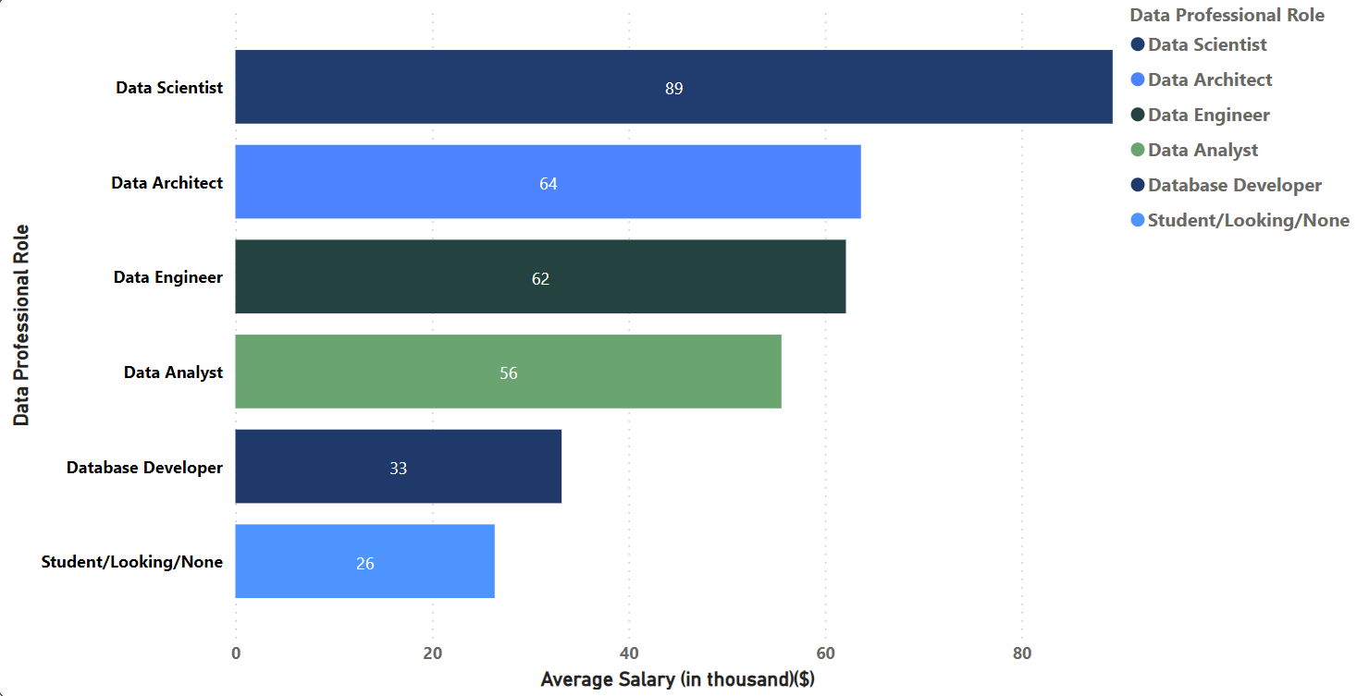
Data Professional Participants Distribution by Role
The analysis reveals a significant presence of data scientists among the various data professionals surveyed. This indicates a strong demand for individuals skilled in advanced analytics, machine learning, and data modeling techniques.

Slide 8
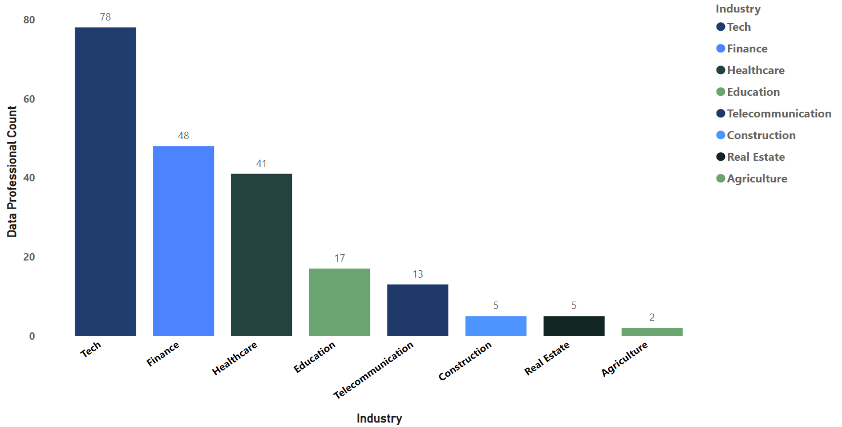
Data Professional Participants Distribution by Industry
The count of data professionals is particularly high in tech industries, highlighting the industry's recognition of the value and importance of data analysis.

Slide 9
Conclusion
The analysis reveals that the count of male data professionals is higher compared to female data professionals. This indicates a gender disparity within the field and highlights the need for initiatives to promote diversity and inclusion.
The survey results indicate relatively low ratings for both salary and work-life balance among data professionals. This finding emphasizes the importance of considering employee well-being in the workplace.
The analysis reveals that the count of data scientists is higher compared to other data professionals, suggesting a growing demand for this role in the industry.
The dataset shows that data professionals are predominantly employed in the technology industry, indicating a strong presence and demand for data expertise in this sector.

